Slide 1
Smart In-situ Visualization for Large-scale Numerical Simulations Aiming at Efficient Knowledge Acquisition
Naohisa Sakamoto naohisa.sakamoto@people.kobe-u.ac.jp
Kobe University / RIKEN R-CCS Kobe, Japan
The 4th China-Japan Joint Visualization Workshop July 24, Wuhan, China (Online)
Notes:
I'm Naohisa Sakamoto from Kobe University, Japan. Today, I'm going to talk about smart in-situ visualization for large-scale numerical simulations aiming at efficient knowledge acquisition. Currently, I'm also a visiting researcher at RIKEN center for computational science. And this work has been done in collaboration with researchers and engineers in RIKEN R-CCS.

Slide 2
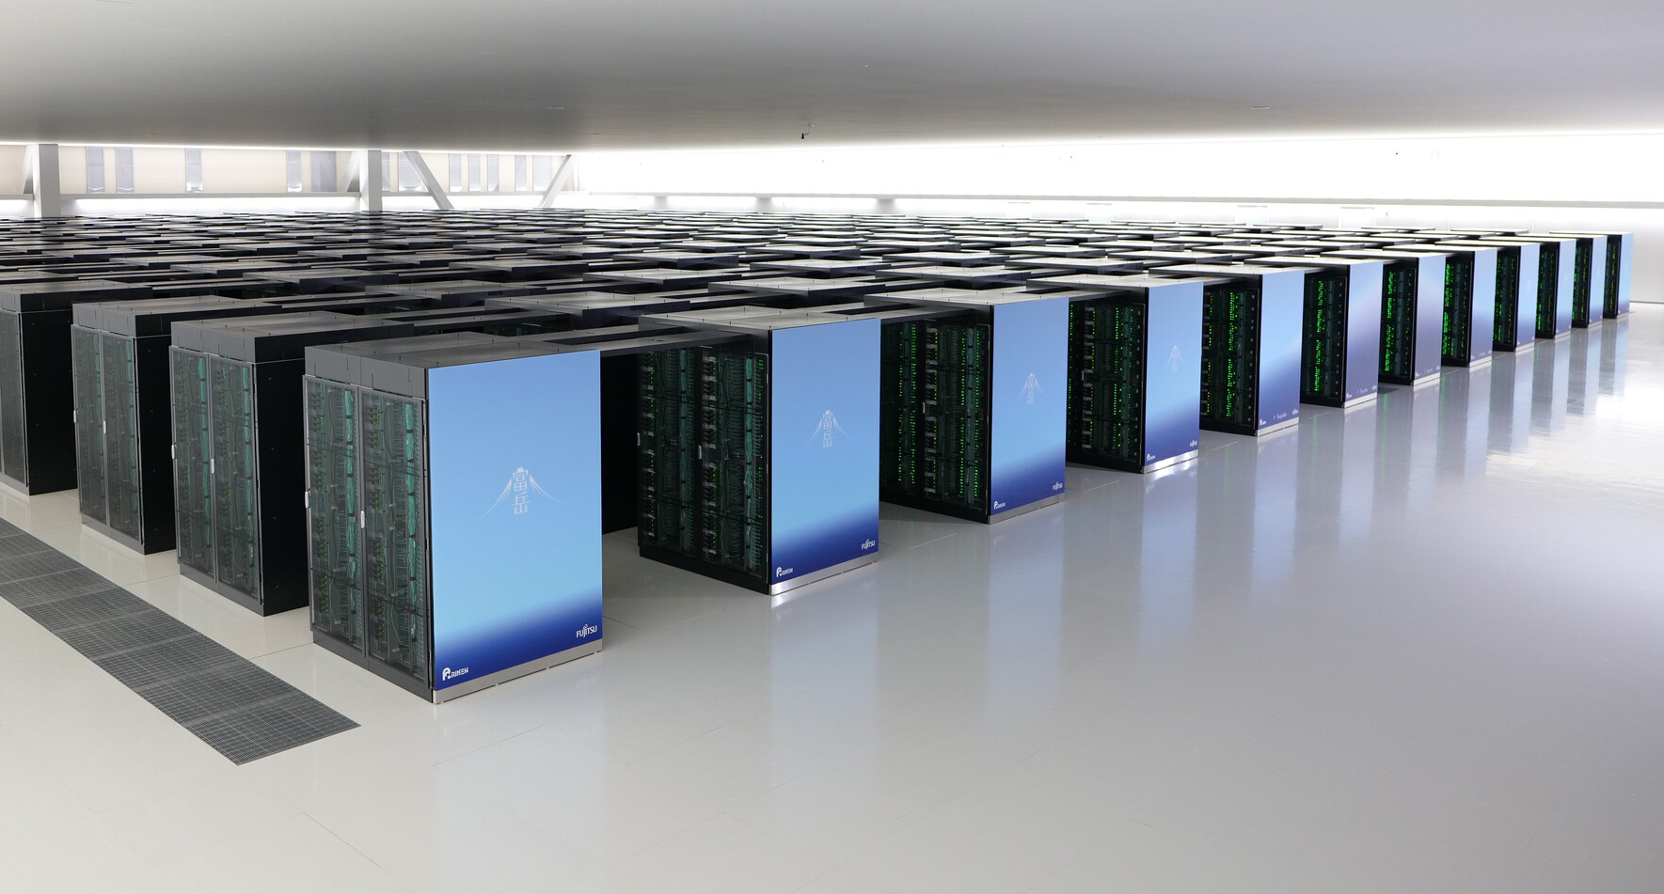
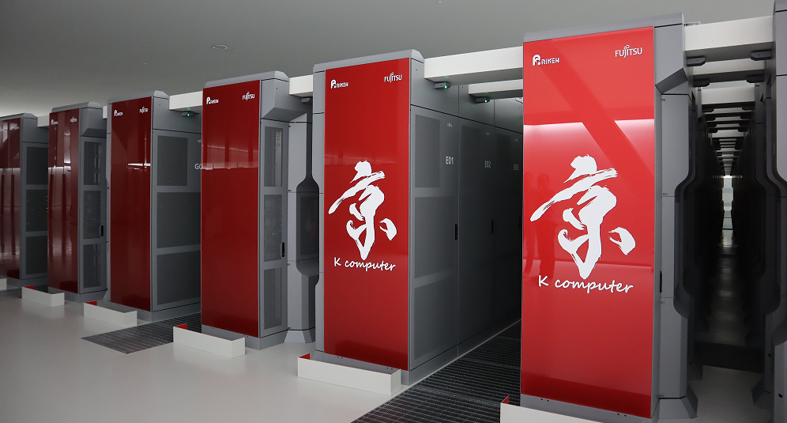
High Performance Computing Systems
Supercomputer Fugaku
158,976 processing nodes
537 PFLOPS
Awarded
Top500, HPCG, HPL-AI, Graph500
Fugaku (ARM-based A64FX)
Mar.2020 - present
Visualization and analysis tasks even more challenging
K computer (SPARK64)
Sep.2012 to Aug.2019
Notes:
First, I would like to briefly introduce background of our work. I think you already know, at the RIKEN Center for Computational Science (R-CCS), the K computer was decommissioned in August 2019 (two thousand nineteen) after several years of continuous service operation, and the Fugaku supercomputer began to be used for shared use in March 2020 (two thousand twenty). The fugaku system is consist of more than 150,000 (one hundred fifty thousand) processing nodes and its peak performance is 537 (five hundred thirty-seven) PetaFLOPS. And it was awarded first place on the TOP500 (five hundred) list - the best-known supercomputing benchmark, as well as HPCG, a measure of supercomputer performance on real-world applications, and HPL-AI, which ranks computers on artificial intelligence related tasks, and Graph500 (five hundred), which gauges a computer's ability to handle data-intensive loads.
Numerical simulations run on such state-of-the-art HPC system become more detailed and complicated, and as a result, its outputs have a much higher spatio-temporal resolution. (CLICK). So, it makes the visualization and analysis tasks even more challenging.

Slide 3
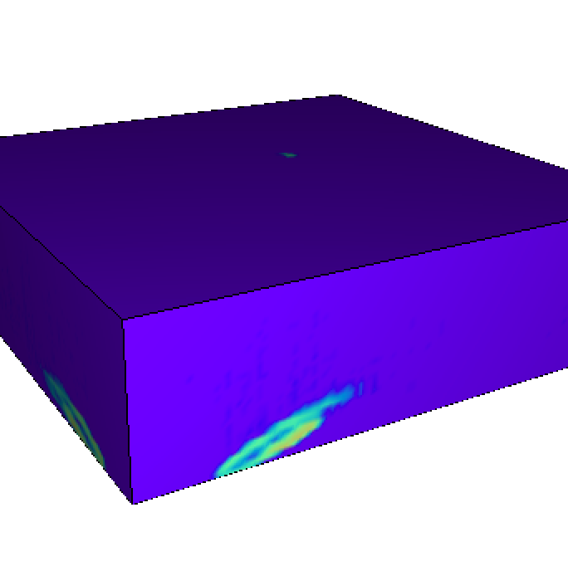
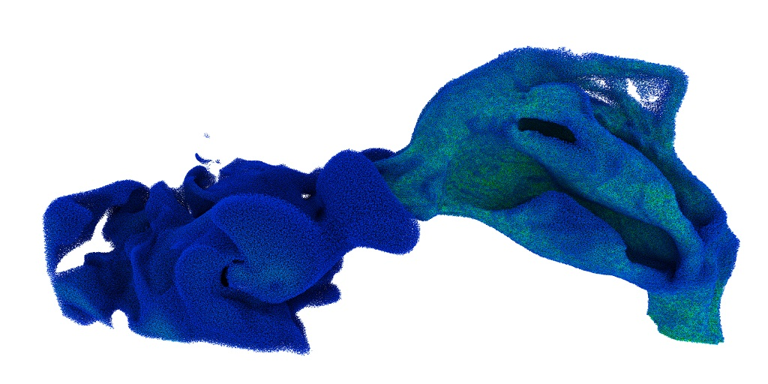
In-situ Visualization
Post-hoc vis.
Transfer data to vis. PC
Rendering on vis. PC (with GPUs)
Data I/O for sim. results is expensive
In-situ vis.
Avoiding data I/O
Rendering directly from sim. results on HPC
Vis. PC
HPC
😩
Simulation
Data I/O
Filtering/Mapping
Analysis
Rendering
Display
Exploring
HPC
😄
Vis. PC
Simulation
Filtering/Mapping
Analysis
Rendering
Display
Exploring
Notes:
To cope with such situations in the area of high-performance computing, there are great expectations for in-situ visualization, which is a technique to visualize simulation data as it is generated.
Classical visualization approach, which called as post-hoc visualization, transfers the simulation data to the visualization PC with GPUs, and then render it interactively with GPU acceleration techniques. However, in this approach, data I/O for the simulation data is very expensive, and this data bottleneck makes visualization practically impossible for HPC-scale dataset.
In contrast, In-situ visualization approach, which renders data as it is being generated from simulation on HPC environment, can avoid data I/O and is widely regarded its necessity in the area of high-performance computing.

Slide 4
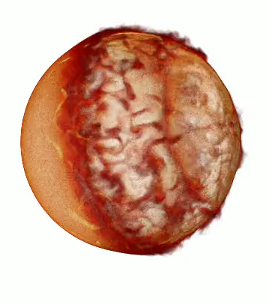
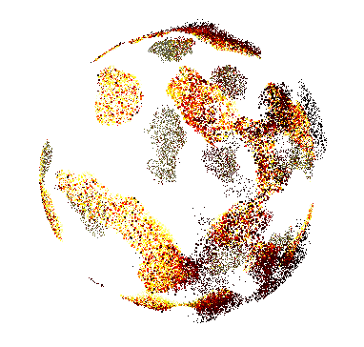
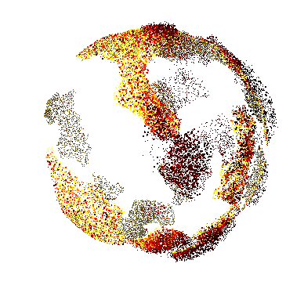
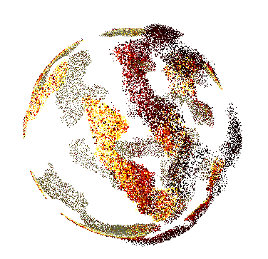
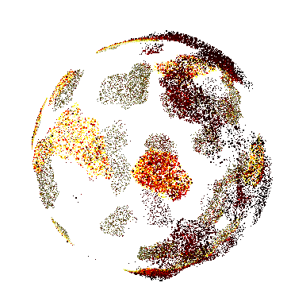
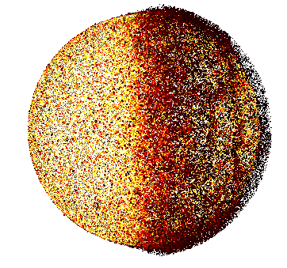
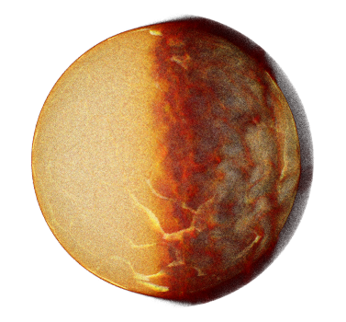
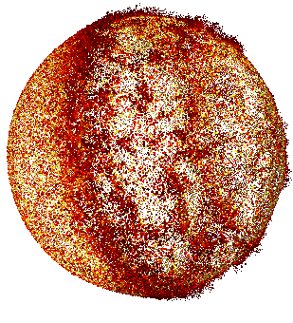
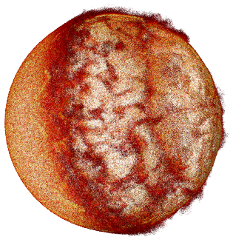
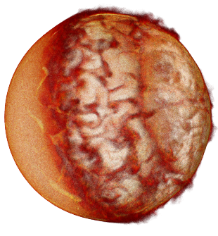
Parallel Rendering
Order-independent technique for volume rendering
Sub Vol 1
Sub Vol 2
Sub Vol 3
Sub Vol m
Final Image
Ensemble
Image 1
…
CFD simulation: Magnus force acting on a rotation ball placed in a uniform flow
19M prism elements
256 sub-volumes
Ensemble
Image 2
…
…
…
…
…
…
…
…
Ensemble Averaging
w/o ordering
Ensemble
Image n
…
1
10
100
Stochastic Rendering
w/o ordering
Image Composition w/o ordering
# of ensemble images
Y. Yamaoka, K. Hayashi, N. Sakamoto, J. Nonaka, A Memory Efficient Image Composition-based Parallel Particle Based Volume Rendering, JASSE, Vol.6, Issue.1, pp.1-10, 2019.3
Notes:
In our group, we have been working with large data visualization since the K computer operational period, targeting large-scale simulation results.
What we are introducing here is a parallel rendering method for large-scale distributed volume dataset generated from HPC systems. In common volume rendering, visibility ordering is required during rendering process, and can cause performance degradation when rendering large-scale data. Especially, in the case of large-scale unstructured volume in distributed computing environment, it causes not only performance degradation but also significant rendering artifacts.
We have developed an order-independent parallel rendering method that eliminates the visibility ordering by using a probabilistic approach, and have achieved efficient rendering for large-scale unstructured volume dataset.

Slide 5
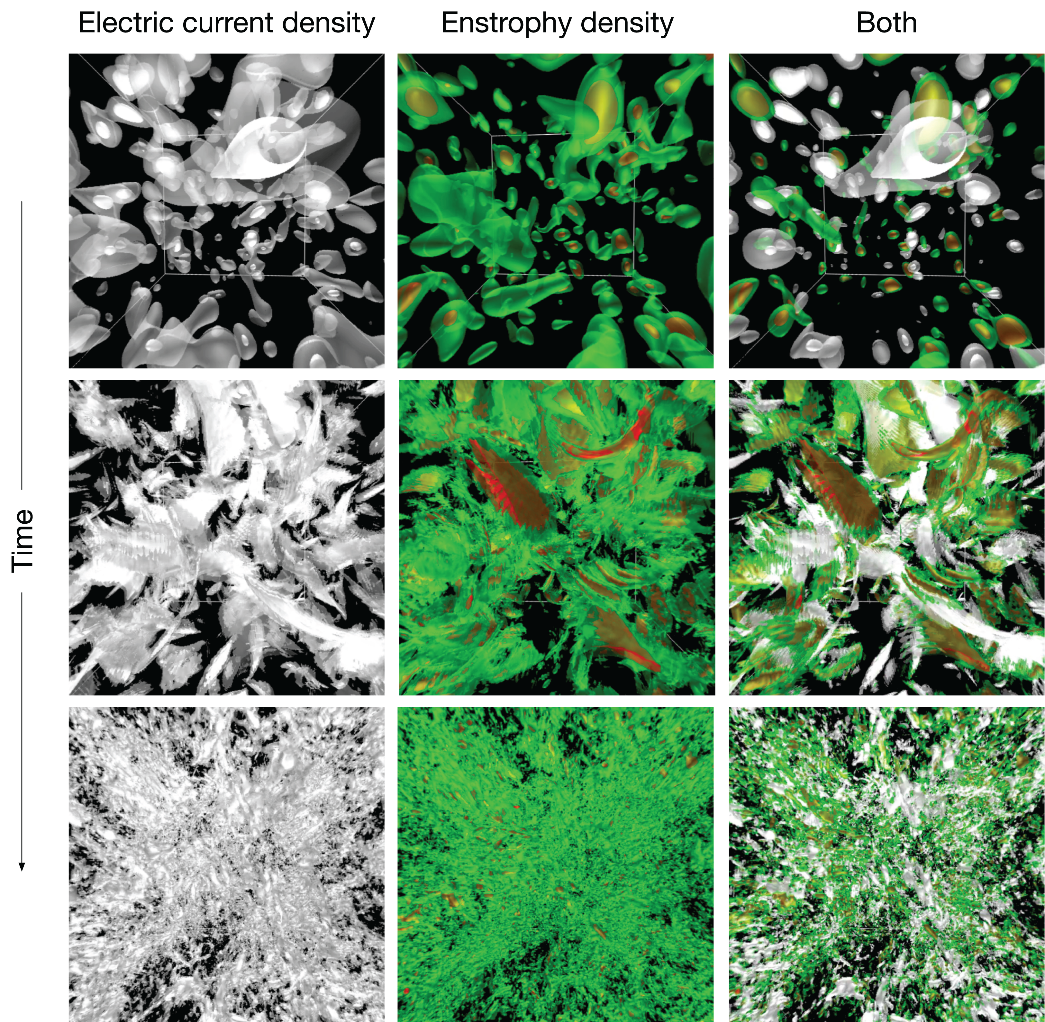
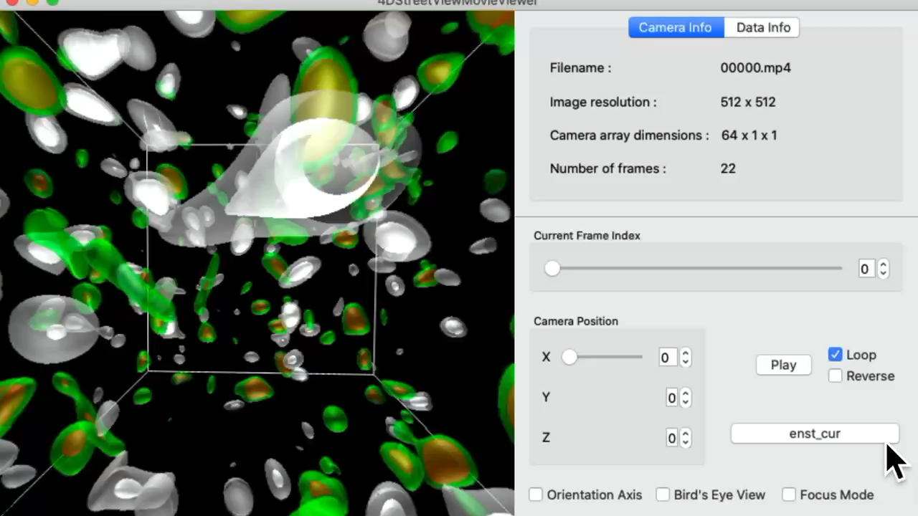
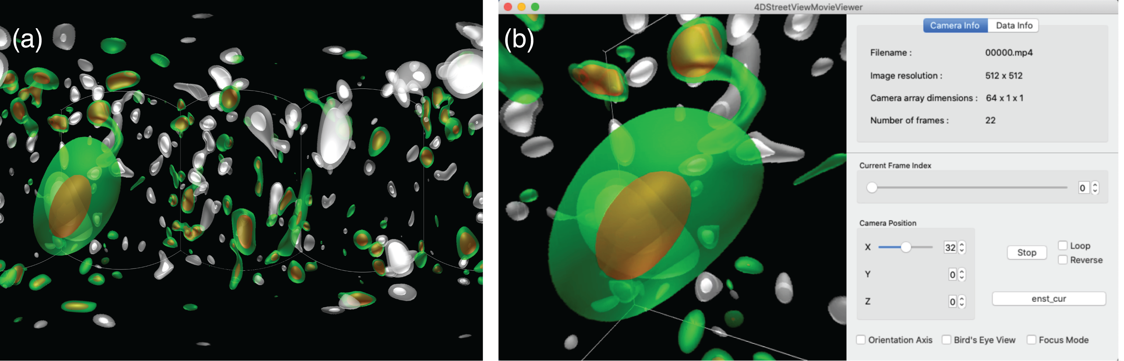
Interactive Exploration for In-situ Vis.
Multi-viewpoint omni-directional rendering
Omni-directional movie
Post-hoc data exploration for in-situ visualization results based on mutli-viewpoint omnidirectional movies.
Gnomonic Projection
In-situ visualization of the hall HMD simulations: Semi-transparent isosurfaces for two different physical quantities.
Akira Kageyama, Naohisa Sakamoto, 4D Street View: A Video-based Visualization Method, PeerJ Computer Science, 6:e305, DOI:10.7717/peerj-cs.305, 2020.9.
Notes:
In addition, we also have proposed a method to realize interactive data exploration for in-situ visualization.
In general, in in-situ visualization, since the images not volume dataset are generated as an output from the system, the camera position and direction cannot be changed after execution, and exploratory operations based on the rendering image results have been constrained.
In the method presented here, a large number of cameras are placed in the visualization space and rendered the scene as omni-direction images, which enable free walk-through data exploration in spatio-temporal space by interactively and freely manipulating the viewpoint after in-situ processing.

Slide 6
In-situ Visualization on HPC
Blind execution
Pre-defined visualization parameters
File staging-based processing
Rendering for time-varying datasets
Large number of output images
😩
Difficult to gain insight into the data and facilitate its understanding
Storage
Compute nodes
Notes:
In addition to our methods, various other techniques and frameworks for in-situ visualization have been proposed to realize efficient visualization for large-scale numerical simulations on HPC environments, and to significantly reduce the time from simulation to visualization.
However, since most of these in-situ approaches require pre-defined visualization parameters before system execution and are executed as batch-job system, a large amount of image dataset or movie files is generated after the processing is completed.
(CLICK)
As a result, there is a new situation (CLICK) in which it is difficult to gain insight into the data and facilitate its understanding.

Slide 7
Smart In-situ Visualization
Time to discover
Reducing the time required to obtain scientific knowledge from the numerical simulation results
Identify the spatio-temporal region to be visualized by automatically evaluating the state changes for the simulation dataset to be calculated
Adaptive sampling method for in-situ vis.
Time
Space
Smart
In-situ
Visualization
😄
Important images
Japan Society for the Promotion of Science (JSPS), Grant-in-Aid for Scientific Research (B) 20H04194, Smart in-situ visualization for large-scale numerical simulations aiming at efficient knowledge acquisition
Notes:
To overcome these problems, in our group, we are now trying to develop a smart in-situ visualization focusing on not only the rendering performance and data exploration but to reduce the time-to-discover to obtain scientific knowledge from the numerical simulation results by eliminating unnecessary rendering or image generation processes.
Currently, we are now focusing on a technique to identify the spatio-temporal region to be visualized by automatically evaluating the state changes for the simulation dataset to be calculated, and are developing adaptive sampling methods for in-situ visualization using time and space as evaluation criteria.
In this talk, I will introduce adaptive time sampling method for in-situ visualization.

Slide 8
In-situ Timestep Selection
Based on the amount of changes between the simulation timesteps
Helpful for the data I/O and visualization cost savings
Easy to find the important features related to the correct understanding of the underlying physical phenomena
Simulation
V₀
V₁
V₂
‥ ‥
V_{t-1}
V_{t}
V_{t+1}
‥ ‥
Visualization
V₀
V₁
V₂
‥ ‥
V_{t-1}
V_{t}
V_{t+1}
‥ ‥
Y. Yamaoka, K. Hayashi, N. Sakamoto, J. Nonaka, In-Situ Adaptive Timestep Control and Visualization based on the Spatio-Temporal Variations of the Simulation Results, ISAV2019, pp.12-16, 2019.11
Notes:
Our in-situ timestep selection is a technique based on the amount of changes of physical quantities between the simulation timesteps, and, by using our technique, it's very helpful for the data I/O and visualization cost savings, and then it might be easy to find the important features related to the correct understanding of the underlying physical phenomena.

Slide 9
In-situ Timestep Selection
Spatio-temporal variations between volumes
Adaptive timestep sampling
…
V_{t-1}
V_{t}
…
Variations
Not important
Important
Timestep
: Vis.
: Not vis.
Time
Notes:
Our in-situ timestep selection technique is composed of mainly two processes. One is a process to calculate spatio-temporal variations between volumes. Second one is adaptive timestep sampling to find the important temporal regions need to be visualized.

Slide 10
Spatio-temporal Variations
Time-varying volume dataset
V_{t}^{m-1}
‥‥
V_{t}^{m}
V_{t}¹
V_{t}²
‥‥
V_{t}^{m+1}
V_{t} = {V_{t}¹,V_{t}², … , V_{t}^{m}, …, V_{t}^{M}}
V₀
V₁
‥ ‥
V_{t}
‥ ‥
Time
0
1
t
Notes:
The dataset to be calculated for the spatio-temporal variations is time-varying volume dataset, and each volume is divided into several sub-volumes.

Slide 11
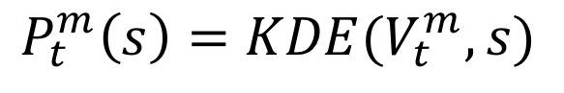

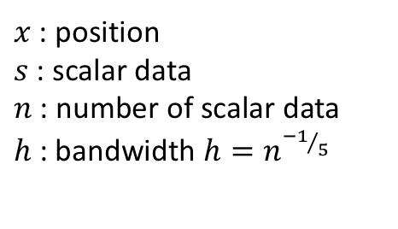
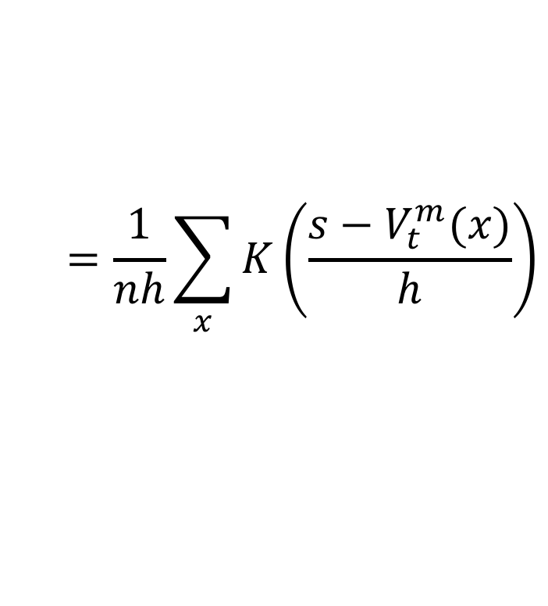
Spatio-temporal Variations
Probability density function P of each sub-volume
Kernel Density Estimation (KDE)
P
P_{t}^{m}
$$P_{t}^{m}\left(s\right)=KDE(V_{t}^{m},s)$$
‥‥
$$=\frac{1}{nh}\sum_{x}{K\left(\frac{s−V_{t}^{m}(x)}{h}\right)}$$
S
V_{t}^{m-1}
$x$: position
$s$: scalar data
$n$: number of scalar data
$h$: bandwidth $h=n^{{−1}/5}$
$K$: Gaussian basis function $$K\left(a\right)=\frac{1}{\sqrt{2π}}e^{{−a^{2}}/2}$$
‥‥
V_{t}^{m}
V_{t}¹
V_{t}²
‥‥
V_{t}^{m+1}
Notes:
First, we estimate probability density function P that means the distribution function of the physical quantity S to be visualized for each sub-volume by using kernel density estimation (KDE).

Slide 12
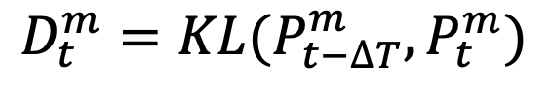
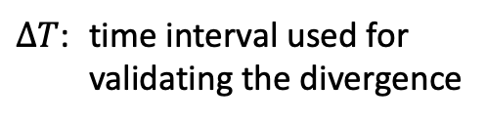
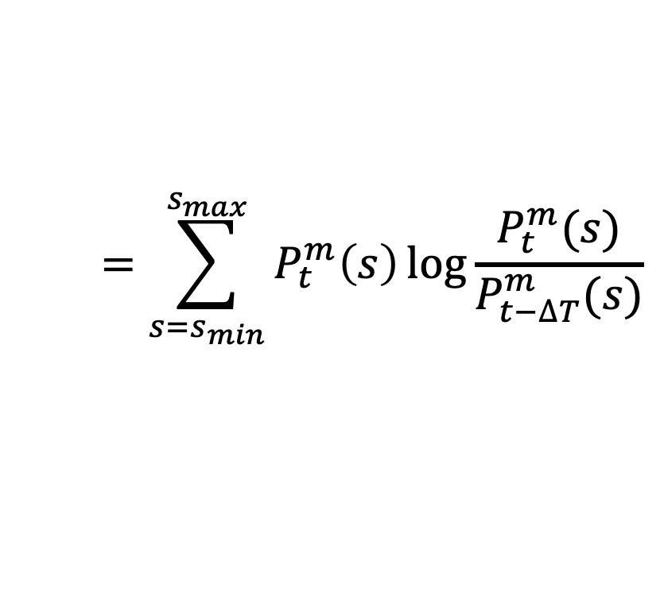
Spatio-temporal Variations
Relative information divergence D between PDFs
Kullback-Leibler (KL) divergence
D_{t}^{m}
^{m}
P_{t-ΔT}
P_{t}^{m}
$$D_{t}^{m}=KL(P_{t−∆T}^{m},P_{t}^{m})$$
$$=\sum_{s=s_{min}}^{s_{max}}{P_{t}^{m}\left(s\right)\log{\frac{P_{t}^{m}(s)}{P_{t−∆T}^{m}(s)}}}$$
‥‥
‥‥
V_{t-ΔT}
V_{t}
$∆T$: time interval used for validating the divergence
Time
t-ΔT
t
Notes:
Next, we measure the relative information divergence between the probability distribution functions PDFs of two sub-volumes separated at delta T time interval, Pt – delta T and Pt. In our method, we use Kullback-Leibler divergence to calculate the information divergence D.

Slide 13
Spatio-temporal Variations
Relative information divergence D between PDFs
Kullback-Leibler (KL) divergence
D_{t}^{m-1}
‥‥
D_{t}^{m}
D_{t}¹
D_{t}²
‥‥
D_{t}^{m+1}
D
D_{t} = max(D_{t}¹, D_{t}², … , D_{t}^{m}, …, D_{t}^{M})
Time
t - ΔT
t
Notes:
And then, since we are interested in the amount of variation in the entire volume data, the set of local Kullback-Leibler divergence values calculated at each of the subvolumes are gathered, and the largest value is used as the amount of variation (Dt ), at the timestep t.

Slide 14
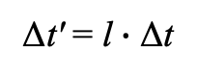
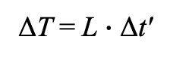
Adaptive Time Sampling
Variation patterns and time intervals
D
Times and Intervals
A
B
C
A
Simulation time
t_{i+1} = t_{i} + Δt
D_{THR}
Visualization time (candidate)
t'_{i+1} = t'_{i} + Δt'
Δt' = l$∙$ Δt
Time
T_{p-1}
T_{p}
T_{p+1}
Validation time for divergence
Δt
Δt’
ΔT
T_{i+1} = T_{i} + ΔT
ΔT = L$∙$ Δt'
t₀
t₁
t₂
‥‥
‥‥
t’_{k-1}
t’_{k}
t’_{k+1}
‥‥
Notes:
Here is the second process of our method, adaptive time sampling.
First, we define three time-values, simulation time, visualization time, and validation time.
The simulation time t can be defined by like this with time interval delta t, and visualization time t prime is like this. Delta t prime means time interval for the visualization process, and l is a timestep interval for delta t. This visualization time is a candidate time for visualization process. Last one is validation time capital T can be defined by using delta capital T. This capital L means a timestep interval for delta t prime.
Then, this graph shows the changes of the divergence. In our method, by giving a threshold value Dthr for the divergence, we divide the region into three sub-regions, A, B, and C. The region A is a region with low variation of the divergence, B is high variation region, and C is a region with variation changing from high to low.

Slide 15

Visualization Interval
Data caching and granularity R for low variation region
T_{p-1}
T_{p}
Time
Δt
Δt’
ΔT
Caching
Rendering
Fine
Visualization Interval
$$R∙∆t′$$
$$1≤R≤L$$
R = 1
R = 2
R = 4
Coarse
Notes:
In our method, a set of data to be visualized within the validation time region is cached, and then actually visualized according to the region patterns.
And, in order to visualize the data smoothly between region patterns, we update the visualization interval with a granularity adjustment parameter R for low variation region.
This parameter R produce the fine time sampling when it's set to 1, and coarser sampling as it's increased.

Slide 16
Visualization Interval
Granularity for each pattern
Pattern A
Coarse sampling
Using specified R
Pattern B
Fine sampling
Using R = 1
Pattern C
Combined sampling
Using R = 1 (fine) in the first half and specified R in the other half
A
B
C
Coarse
(Specified R)
Fine
(R = 1)
Fine
(R = 1)
Coarse
(Specified R)
Notes:
This shows the settings of granularity for each pattern.
The pattern A is a coarse sampling region. In this region, we use the specified granularity R.
The pattern B is a fine sampling region, and we use the R of 1 for this region.
For the pattern C, we use the R of 1 in the first half and the specified R in the other half.

Slide 17
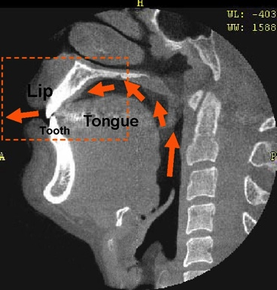
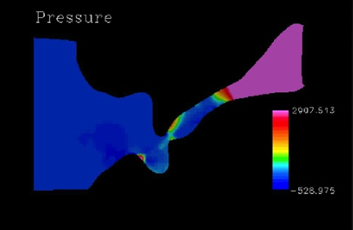
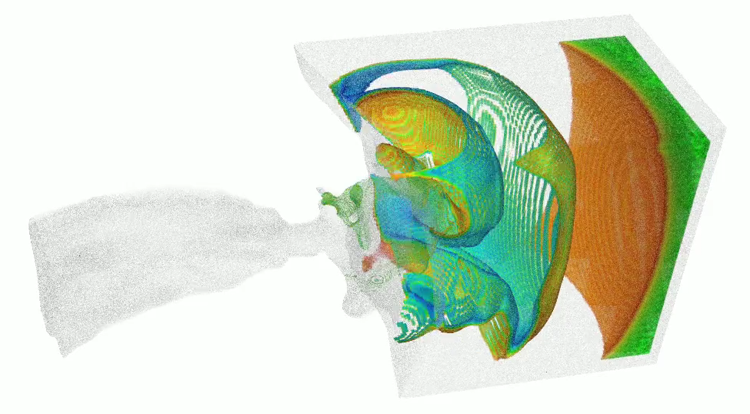
Experiment
Numerical simulation of sibilant fricatives
Implicit compressible flow solver based on OpenFOAM
Unstructured volumes
3,197,279 hexahedrons
48 sub-volumes
20,000 timesteps
Tsukasa Yoshinaga, Kazunori Nozaki, and Shigeo Wada. Experimental and numerical investigation of the sound generation mechanisms of sibilant fricatives using a simplified vocal tract model. Physics of Fluids 30, 3, 2018).
Notes:
Now, we show experimental results.
In order to confirm the effectiveness of our proposed method, we apply to the numerical simulation of sibilant fricatives.
This simulation solver is implemented based on OpenFOAM, and generate hexahedral unstructured volumes divided into 48 sub-volumes with 20,000 timesteps.

Slide 18
Experiment
Simple framework for in-situ vis.³
Adaptive timestep selection
Multi-viewpoint rendering
Omni-directional rendering
Parallel irregular volume rendering
Environment
K pre-post cloud system
X86 based on-premise could system
Dual Intel Xeon Platinum 8168 (Skylake) 24cores/2.7GHz
48 vCPUs on the VM for the evaluation
Software
Simulation: OpenFOAM
Visualization framework: KVS¹
Software rasterizer: OSMesa (LLVMpipe)
Rendering method:
Parallel particle-based rendering¹
234 image composition²
InSituVis::TimestepControlledAdaptor vis( MPI_COMM_WORLD );
vis.setImageSize( 1024, 1024 );
vis.setAnalysisInterval( l );
vis.setValidationInterval( L );
vis.setGranularity( R );
vis.setDivergenceThreshold( D_thr );
vis.setViewpoint( { {p} } );
vis.setPipeline( [](Screen& s, Object& o) { ... } );
...
while ( runTime.run() )
{
auto field = sim.exec(t);
...
InSituVis::Converter conv( vis.world() );
vis.put( conv.exec( field ) );
vis.exec( {runTime.value(), runTime.timeIndex()} );
...
}
...
Example code
https://github.com/naohisas/KVS
https://github.com/avr-aics-riken/234Compositor
https://github.com/vizlab-kobe/InSituVis (private)
Notes:
For the evaluations, we use a cloud computing system for the K computer, not Fugaku. We are currently setting up in-situ system on the Fugaku system and it's almost fine, but the experimental results were not available in time for this talk. Sorry.
Software used for system implementation of our proposed method is here. Some of them are opened at github.
The source code of the proposed method will also be available on github, but it is currently set to private repository.
We now plan to release it to the public as a simple framework for in-situ processing after evaluation on the Fugaku system.

Slide 19
Result
Changes of KL divergence (D)
Simulation timesteps: 20,000
Validation time interval for KL divergence (ΔT /Δt) : 100
Visualization timestep intervals (l) : 5
Validation timestep intervals (L) : 20
KL divergence
Time step
Notes:
Here is an experimental result. This graph shows the changes of KD divergence for the simulation results.
These are input parameters used for this experiment.
The results show that the state changes are relatively low in the first half of the time domain, and the changes are high in the second half of the time domain.

Slide 20
Result
Number of vis. images and reduction rate
Total number of stacked data: 4,000
D_{THR} | R=5 (fine sampling) | R=10 (coarse sampling)
0 | 4,000 (0%) | 4,000 (0%)
0.01 | 3,452 (13.7%) | 3,384 (15.4%)
0.02 | 3,100 (22.5%) | 2,896 (21.6%)
0.03 | 2,856 (28.6%) | 2,616 (34.6%)
0.04 | 2,496 (37.6%) | 2,288 (42.8%)
0.05 | 2,064 (48.4%) | 1,892 (52.7%)
D_{THR}: Threshold for the KL divergence (D)
R: Granularity for the time sampling for A and C interval patterns
Notes:
This table shows the number of generated visualization images using our method and its reduction rate, when using R as being 5 and 10.
Dthr is threshold for the KL divergence, the result for the Dthr of 0 represent a result without our method.
From this result, it can be confirmed that the image reduction rate increases as Dthr is increased, and when Dthr is 0.05, the number of images is reduced by approximately 50%.

Slide 21
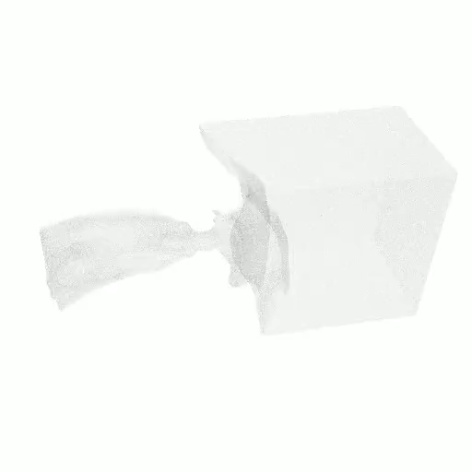
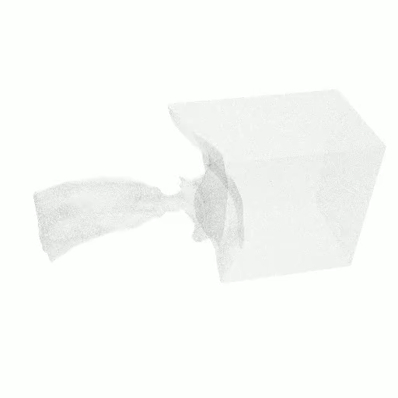
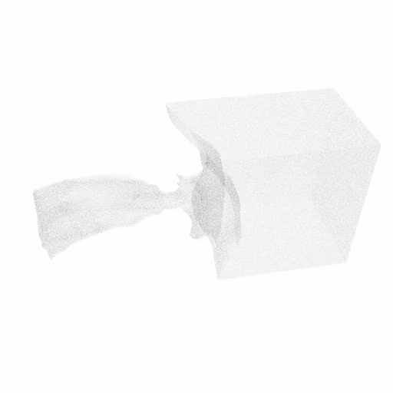
Result
In-situ visualization results w/ and w/o our method
D_{THR} = 0.05
Original
(4,000 images)
Our method with R=5
(2,064 images)
Our method with R=10
(1,892 images)
Notes:
We show the resulting movies created with and without our proposed in-situ visualization method.
Left one is an original rendering movie created by using images at all of the simulation timesteps.
Middle one and right one are rendering movies generated by using our proposed method.
Although both movies are created by using approximately half of the original images, they look almost identical to the original movie.
We also received feedbacks from the domain specialists that we can confirm the significant phenomenon of the state changes occurred in the second half of the simulation results on the movies.

Slide 22
Conclusion
Large data visualization on HPC
Order-independent technique for parallel rendering
Multi-viewpoint omni-directional rendering for in-situ visualization
Smart In-situ visualization
Focusing on “time-to-discover” not only time-to-solution/rendering
Adaptive timestep selection for smart in-situ visualization
Spatio-temporal variations between the simulation results based on the Kullback-Leibler divergence
Adaptive timestep control in consideration of the variation changing patterns
Utilizing adaptive timestep sampling mechanism for reducing the amount of data for the subsequent processing (e.g., data storing for the post-hoc visualization and analytics, in-situ/in-transit visualization)
Notes:
Finally, I would like to conclude our talk here.
In this talk, first, I introduced our previous methods for large data visualization on HPC systems. And then, I explained about smart in-situ visualization focusing on time-to-discover not only time-to-solution/rendering.
In particularly, I gave a detailed explanation of adaptive timestep selection method for smart in-situ visualization.

Slide 23
Future Works
Optimal parameter estimation for the input time intervals
Tuning and evaluation on Fugaku and other HPC systems
Viewpoint selection without missing significant physical phenomenon
Notes:
In future work, we have a plan to develop a technique for optimal parameter estimation for the time intervals used in our adaptive method, and also to tune and evaluate our in-situ framework on Fugaku and other HPC systems.
And now, we are also investigating an adaptive viewpoint selection technique without missing significant physical phenomenon from the detailed simulation results.

Slide 24
Acknowledgements
This work was partially supported by Japan Society for the Promotion of Science (JSPS), Grant-in-Aid for Scientific Research (KAKENHI)
20H04194
19H03976
Collaborators
Jorji Nonaka (RIKEN R-CCS)
Takashi Shimizu, Kengo Hayashi, Yoshiaki Yamaoka (Former Kobe U student)
Tsukasa Yoshizaki (Toyohashi University of Technology)
Kazunori Nozaki (Osaka University)

